Slide 1
Depression Detection From Bangla Social Media Text Using Long Short Term Memory
CSE712
Research Proposal
Group 15
Md Tanzim Reza
ID-21166055
Farzad Ahmed
ID-21166054
Saquib Ahmed
ID-21166021

Slide 2
Introduction
In the modern era, we use social media to express emotions
Depression detection from social media can be useful
Depression detection from social media data using LSTM
Previous works
Depression detection from interview text using LSTM
Depression detection from Bangla social media data in 2019

Slide 3
Data collection
From Facebook and Twitter
Usage of automated scrapping through selenium
English to Bangla character conversion using phonetic converter
Labeling by professionals

Slide 4
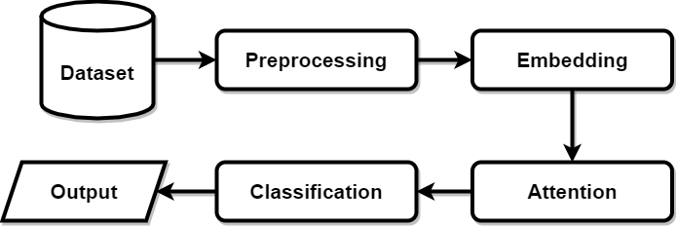
Proposed Method

Slide 5
Proposed Method
Embedding:
1. Word2Vec
2. Glove
3. FastText
4. Transformer
Attention:
1. Global Attention
2. Self Attention
Classification:\
1. Attention

Slide 6
Limitation
Writing Bangla using English characters. (For example: Ami Bangladeshi)
Usage of smileys in sarcastic manner. (For example: জীবন কঠিন! )))))
Conclusion
Future works

